Slide 1









A JAVA PROJECT
HOSPITAL MANAGEMENT SYSTEM
By: Group 3

Slide 2

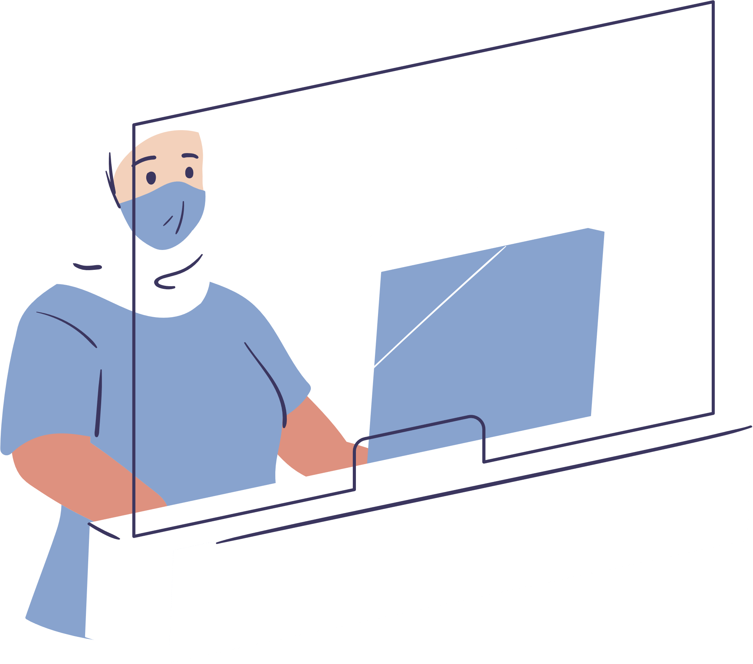

Introduction
The Hospital Management System (HMS) is a Java-based console application designed to automate and streamline the essential operations of a hospital. It provides an organized platform to manage patients, doctors, appointments, billing, and emergency services efficiently.
Simplifying Healthcare Through Smart Management
Built using Object-Oriented Programming principles, the system follows a modular structure, making it easy to maintain and scale. Each component handles a specific functionality, ensuring clarity and smooth user interaction through a simple command-line interface.
This project aims to replicate core hospital workflows, reduce manual effort, and improve service delivery, offering a reliable tool for managing daily healthcare operations.

Slide 3


Problem Statement
Hospitals often rely on manual or semi-digital systems to manage patient records, doctor availability, appointment scheduling, billing, and emergency responses. These fragmented and outdated processes can lead to:
Inefficient data handling and delays in patient service
Overlapping or missed appointments due to poor scheduling
Time-consuming billing processes with potential errors
Lack of real-time support for emergency cases
Inadequate monitoring of patient wellness and mental heal
Such inefficiencies not only disrupt hospital workflow but also compromise the quality of patient care. There is a clear need for a centralized, automated system that can streamline hospital operations and improve overall service delivery.

Slide 4

Proposed Solution
To address the inefficiencies in traditional hospital management, this project proposes a Java-based Hospital Management System that consolidates core operations into a single, modular application. The system is designed to:
Automate appointment scheduling
Streamline billing processes with accuracy
Centralize patient and doctor records for easy access and management
Simulate emergency alert handling for faster response in critical situations
Monitor mental wellness using an interactive wellness bot and generate simple health reports

Slide 5

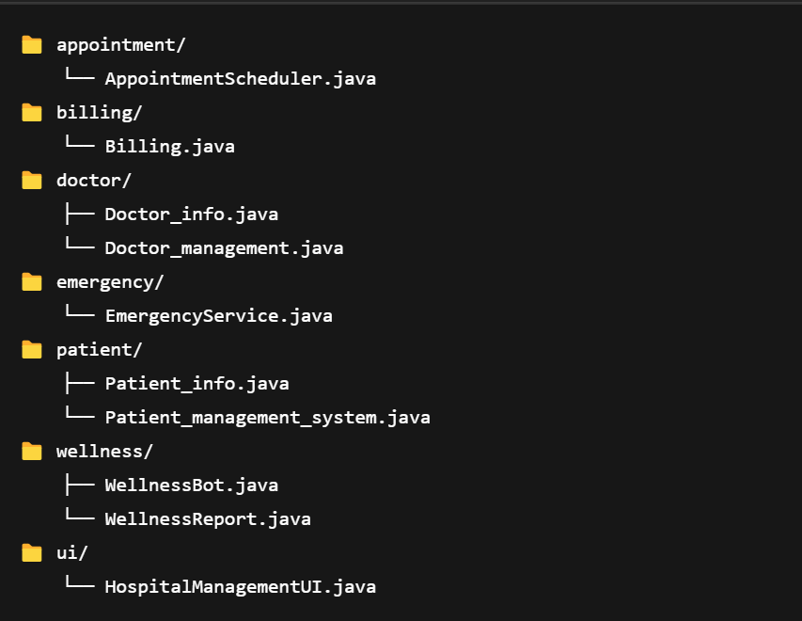

Basic Structure of the System

Slide 6
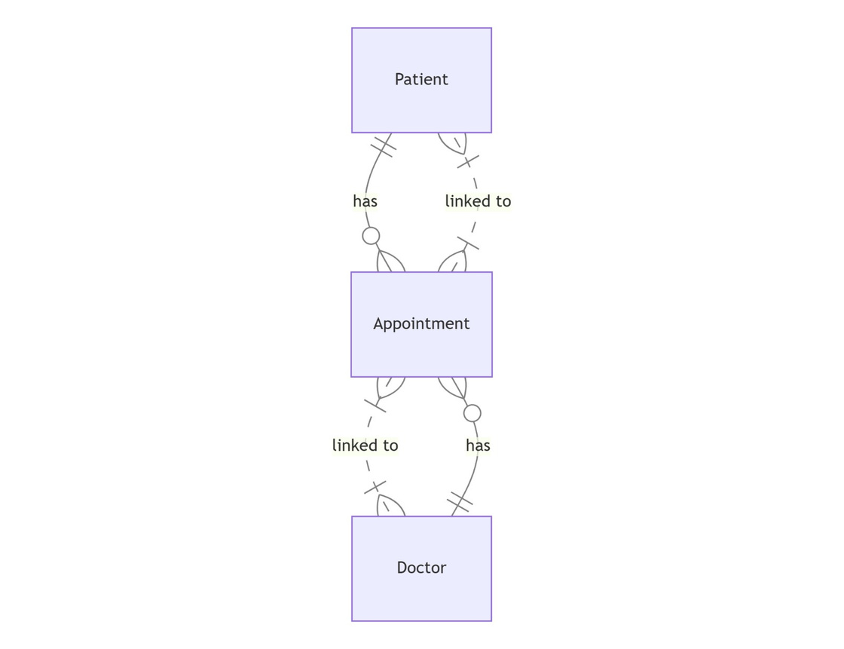
ER Diagram of the System

Slide 7
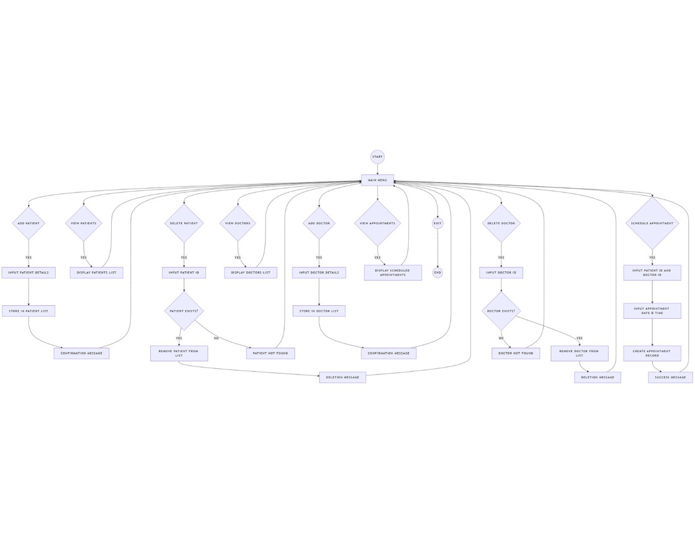
Data Flow Diagram of the System

Slide 8
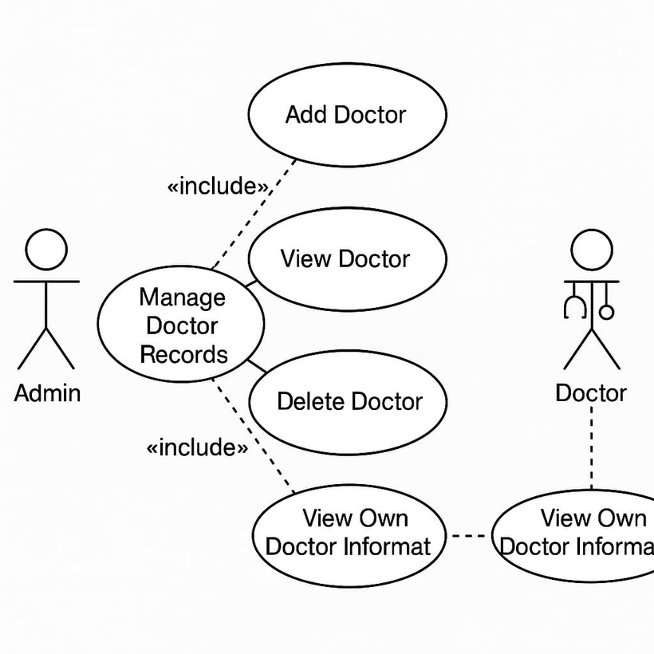
Use Case Diagram of the System

Slide 9
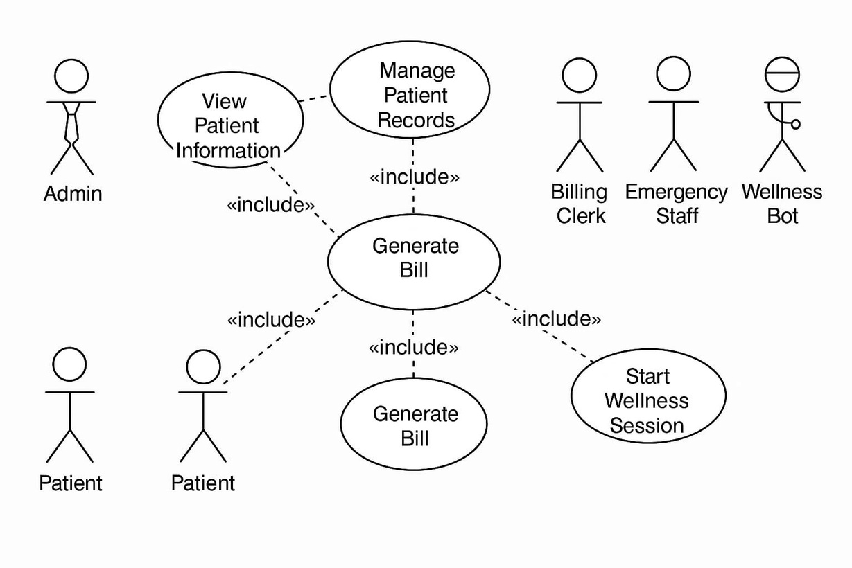
Use Case Diagram of the System

Slide 10
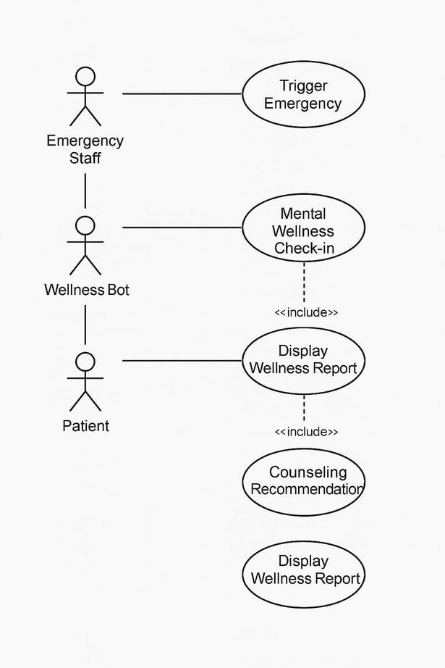
Use Case Diagram of the System

Slide 11
Features
The Hospital Management System is built using a modular, object-oriented approach in Java. The application is organized under a single package with multiple classes, each responsible for handling a specific hospital-related operation. Here is a detailed overview of its features, along with the structure and functionality of each class:
Patient_management_system (Main Class)
This is the entry point of the application that manages user interaction and menu-driven operations.
Key Responsibilities:
Displays the main menu and handles user choices
Calls appropriate modules for operations like managing patients, appointments, billing, wellness checks, and emergencies
Core Methods:
main(String[] args) – Initiates the system and handles the flow of the program
Contains switch-case logic to route user input to corresponding modules

Slide 12
Features
The Hospital Management System is built using a modular, object-oriented approach in Java. The application is organized under a single package with multiple classes, each responsible for handling a specific hospital-related operation. Here is a detailed overview of its features, along with the structure and functionality of each class:
patient package
Class: Patient_management_system
Functionality: Handles overall patient data management.
Methods:
addPatient(), viewPatients(), searchPatient(), deletePatient(): CRUD operations.
loadPatientsFromFile(), savePatientsToFile(): Persistence features.
main(): Entry point for the patient management system.

Slide 13
Features
patient package
Class: Patient_info
Functionality: Manages patient details.
Methods:
Patient_info(): Constructor.
getid(), getname(), getage(), getdisease(), getaddress(), getcontact(): Getter methods.
display_patient_info(): Displays all patient information.
appointment package
Class: AppointmentScheduler
Functionality: Handles the scheduling of appointments between patients and doctors.
Methods:
scheduleAppointment(ArrayList<Patient_info> patients): Prompts for patient ID and schedules an appointment using available doctor info.

Slide 14
Features
billing package
Class: Billing
Functionality: Manages patient billing operations.
Methods:
generateBill(): Likely generates a bill for services used by the patient.
doctor package
Class: Doctor_info
Functionality: Stores and manages individual doctor data.
Methods:
Doctor_info(): Constructor.
getDoctorId(), getName(), getSpecialization(), getContact(): Accessor methods.
displayDoctorInfo(): Prints doctor information.

Slide 15
Features
doctor package
Class: Doctor_management
Functionality: CRUD operations for doctor records.
Methods:
loadDoctorsFromFile(), saveDoctorsToFile(): Load/save doctor data to files.
addDoctor(): Adds a new doctor.
viewDoctors(): Lists all doctors.
BufferedReader, BufferedWriter: Possibly used in IO operations (may be false positives in method detection).
emergency package
Class: EmergencyService
Functionality: Manages emergency response mechanisms in the hospital.
Methods:
triggerEmergency(): Simulates or triggers emergency protocols.

Slide 16
Features
GUI package
Class: HospitalManagementGUI
Functionality: Main user interface for hospital management (likely GUI-based).
Methods:
HospitalManagementUI(): Constructor for initializing UI.
actionPerformed(...): Multiple methods handling user actions/events.
main(): Launches the application.
wellness package
Class: WellnessBot
Functionality: A chatbot or automated check-in system for health monitoring.
Methods:
checkIn(): Starts a session for user health status.
startSession(): Begins interaction.
(Some misidentified logic elements like if())

Slide 17
Features
wellness package
Class: WellnessReport
Functionality: Generates reports related to patient wellness.
Methods:
WellnessReport(): Constructor.
displayReport(): Displays the wellness status.
needsCounseling(): Determines if the patient needs further support.

Slide 18
Challenges
While developing the Hospital Management System, several technical and design-related challenges were encountered:
The system currently does not use a database. This limits the application's ability to store long-term medical records and user history.
The emergency alert system is currently a simulated feature. Implementing real-time emergency alerts with accurate location tracking and third-party service integration (like ambulances or police) would require external APIs and infrastructure.
The mental wellness feature operates on simple Q&A logic, which may not be sufficient for comprehensive wellness analysis. Designing meaningful responses while keeping the logic lightweight was a delicate balance.

Slide 19

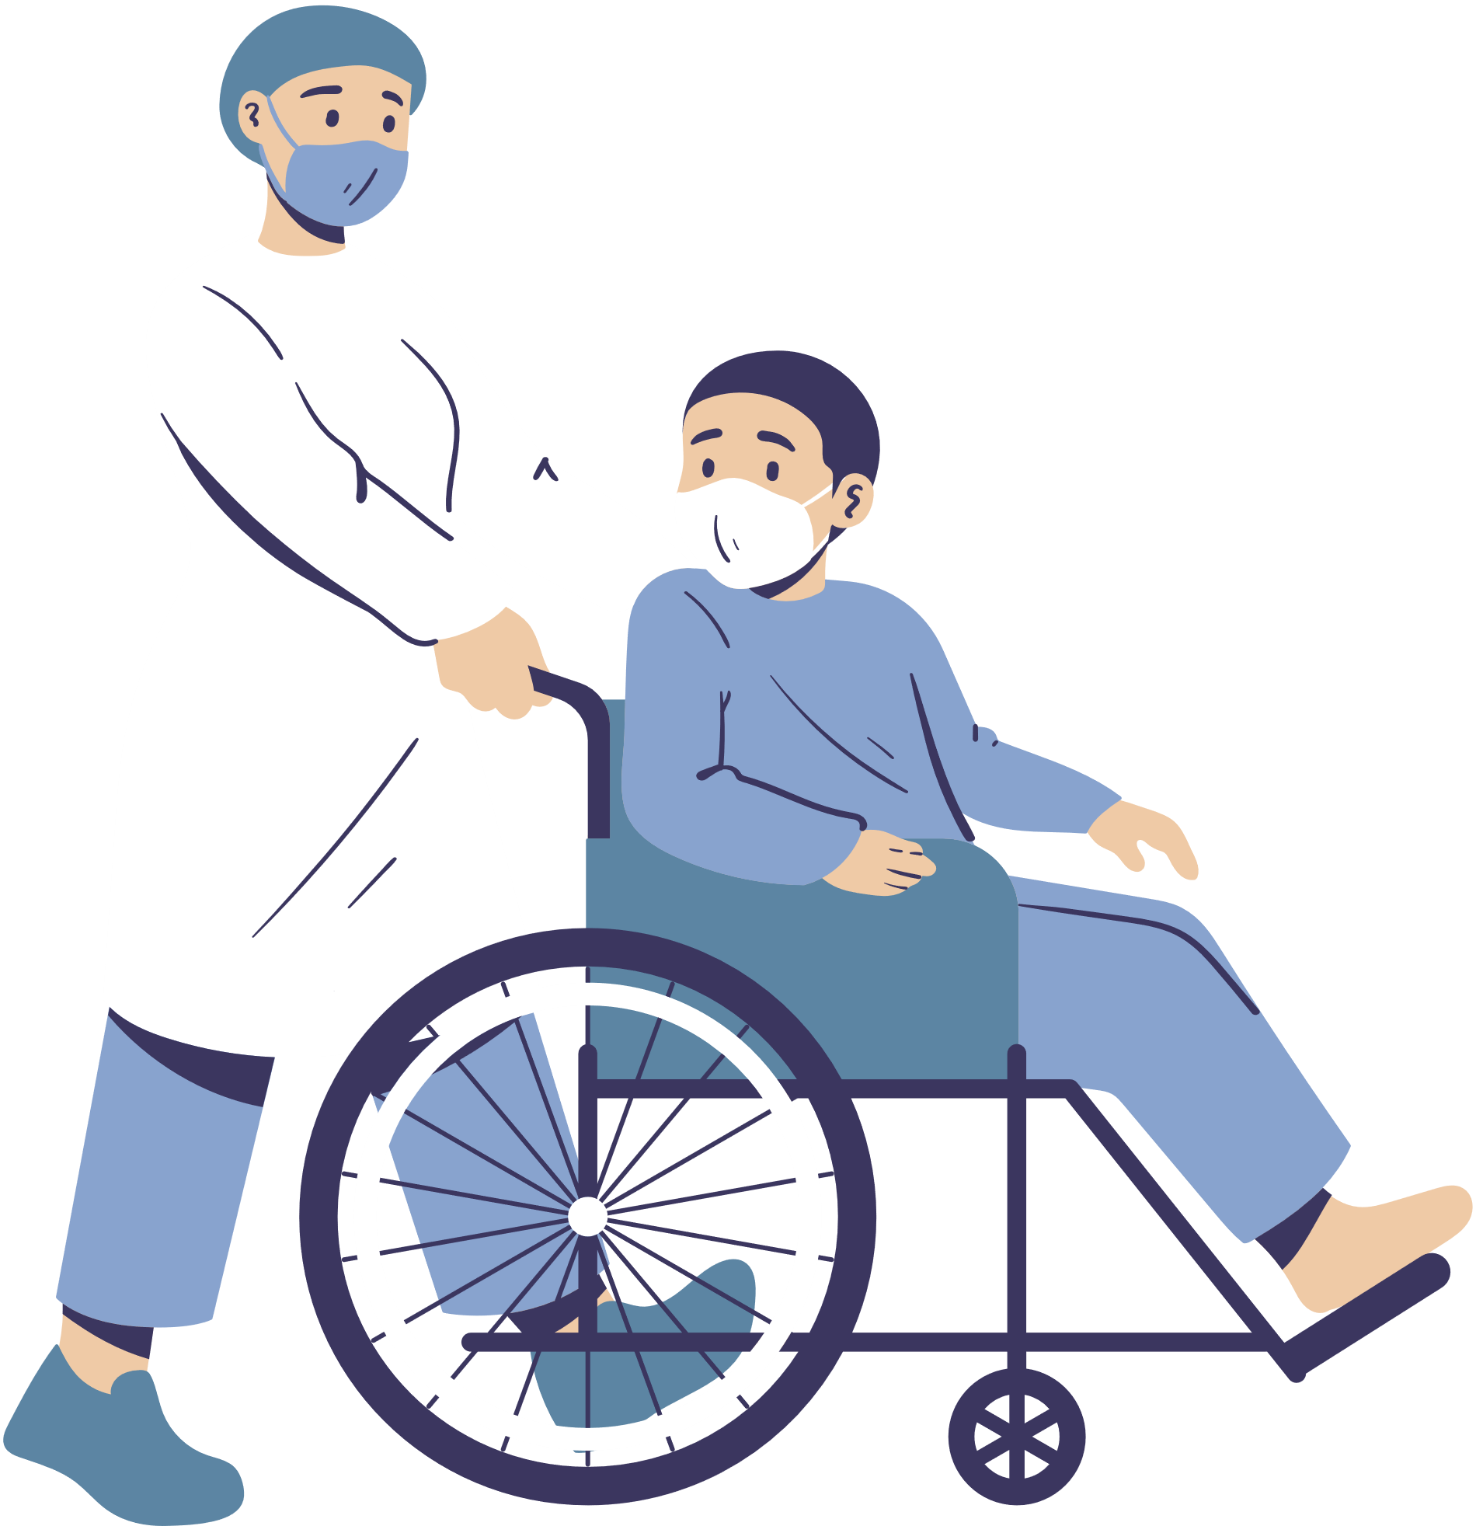
Future Enhancements
As a console-based application, this Hospital Management System serves as a strong foundation for more advanced features and real-world integration. Below are some potential enhancements that could greatly improve its functionality, user experience, and scalability:
Database Integration
Real-Time Emergency Response Integration
Connect the system to a relational database like MySQL or SQLite to store patient records, doctor information, and billing details persistently.
Enable long-term record management, search filters, and historical data analysis.
Integrate APIs for location tracking and emergency services to send real-time alerts to ambulances or nearby hospitals.
Use SMS or push notifications for immediate communication in critical cases.
AI-Powered Wellness Bot
Role-Based User Authentication
Upgrade the mental wellness feature using Natural Language Processing (NLP) to analyze open-ended responses and offer more personalized suggestions.
Include voice input and integration with wearable devices for health tracking.
Implement secure login for different user roles such as admin, doctor, patient, and receptionist.
Provide controlled access to features based on roles and responsibilities.

Slide 20
Project By
Vanshika Munjal 500121784
Vaani Jindal 500119144
Shagun Kimothi 500120283
Batch: B-2 CCVT

Slide 21
Thank you for your attention

